Slide 1
UNIT-III
The Control Unit

Slide 2
Syllabus Contents
Instruction Cycle & Micro Operations, Functional Requirements & Operations of the Control Unit, Block Schematic & Control Signals, Single Bus Processor Organization
Control Signal example with Micro Operations and Register Transfer.
Control Unit Design Methods - Hardwired Control – State Table Method, Design example – Multiplier CU.
Micro-Programmed Control - Basic Concepts, Microinstructions & Formats, Control Memory, Micro-Programmed Control Unit Schematic, Microinstruction Sequencing - Design Considerations,
Sequencing Techniques, Address Generation, Microinstruction Execution - A Taxonomy of Microinstructions, Microinstruction Encoding.

Slide 3
Micro-Operations
A computer executes a program-Fetch/execute cycle.
Each instruction is executed during an instruction cycle made up of shorter subcycles (e.g., fetch, indirect, execute, interrupt).
The execution of each subcycle involves one or more shorter operations(or steps),that is, micro-operations.
Each step does very little atomic operation of CPU.
Micro-operations are the functional, or atomic, operations of a processor.
It helps in designing of control unit.

Slide 4
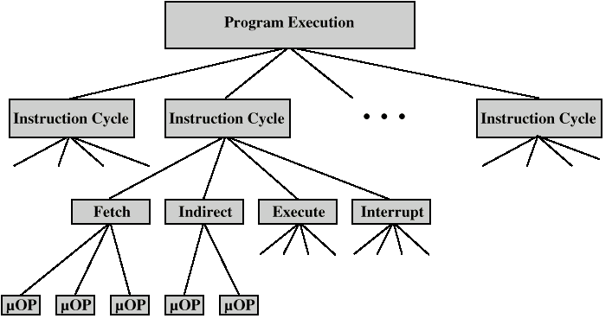
Constituent Elements of a Program Execution

Slide 5
Fetch - 4 Registers
Memory Address Register (MAR)
Connected to address bus
Specifies address for read or write op
Memory Buffer Register (MBR)
Connected to data bus
Holds data to write or last data read
Program Counter (PC)
Holds address of next instruction to be fetched
Instruction Register (IR)
Holds last instruction fetched

Slide 6
Fetch Sequence
Address of next instruction is in PC
Address (MAR) is placed on address bus
Control unit issues READ command
Result (data from memory) appears on data bus
Data from data bus copied into MBR
PC incremented by 1 (in parallel with data fetch from memory)
Data (instruction) moved from MBR to IR
MBR is now free for further data fetches

Slide 7
Fetch Sequence (symbolic)
t1: MAR <- (PC)
t2: MBR <- (memory)
PC <- (PC) +1
t3: IR <- (MBR)
(tx = time unit/clock cycle)
OR
t1: MAR <- (PC)
t2: MBR <- (memory)
t3: PC <- (PC) +1
IR <- (MBR)

Slide 8
Rules for Clock Cycle Grouping
Proper sequence must be followed
MAR <- (PC) must precede MBR <- (memory)
Conflicts must be avoided
Must not read & write same register at same time
MBR <- (memory) & IR <- (MBR) must not be in same cycle
Also: PC <- (PC) +1 involves addition
Use ALU
May need additional micro-operations

Slide 9
Indirect Cycle
MAR <- (IR_{address}) - address field of IR
MBR <- (memory)
IR_{address} <- (MBR_{address})
MBR contains an address
IR is now in same state as if direct addressing had been used

Slide 10
Interrupt Cycle
t1: MBR <-(PC)
t2: MAR <- save-address
PC <- routine-address
t3: memory <- (MBR)
This is a minimum
May be additional micro-ops to get addresses
Note: saving context is done by interrupt handler routine, not micro-ops

Slide 11
Execute Cycle (ADD)
Different for each instruction
e.g. ADD R1,X - add the contents of location X to Register 1 , result in R1
t1: MAR <- (IR_{address})
t2: MBR <- (memory)
t3: R1 <- R1 + (MBR)
Note: no overlap of micro-operations

Slide 12
Execute Cycle (ISZ)
ISZ X - increment and skip if zero
t1: MAR <- (IR_{address})
t2: MBR <- (memory)
t3: MBR <- (MBR) + 1
t4: memory <- (MBR)
if (MBR) == 0 then PC <- (PC) + 1
Notes:
IF is a single micro-operation
Micro-operations done during t4

Slide 13
Execute Cycle (BSA)
BSA X - Branch and save address
Address of instruction following BSA is saved in X
Execution continues from X+1
t1: MAR <- (IR_{address})
MBR <- (PC)
t2: PC <- (IR_{address})
memory <- (MBR)
t3: PC <- (PC) + 1

Slide 14
Instruction Cycle
Each phase decomposed into sequence of elementary micro-operations
E.g. fetch, indirect, and interrupt cycles
Execute cycle
One sequence of micro-operations for each opcode
Need to tie sequences together
Assume new 2-bit register
Instruction cycle code (ICC) designates which part of cycle processor is in
00: Fetch
01: Indirect
10: Execute
11: Interrupt

Slide 15
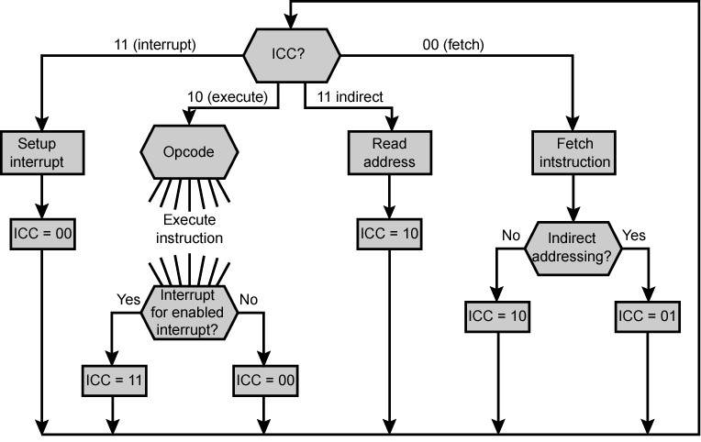
Flowchart for Instruction Cycle

Slide 16
Functional Requirements
Define basic elements of processor
ALU
Registers
Internal data pahs
External data paths
Control Unit
Describe types of micro-operations that processor performs
Transfer data between registers
Transfer data from register to external
Transfer data from external to register
Perform arithmetic or logical ops

Slide 17
Functional Requirements (cont..)
Determine functions/operations control unit must perform
Sequencing
Causing the CPU to step through a series of micro-operations
Execution
Causing the performance of each micro-op
This is done using Control Signals

Slide 18
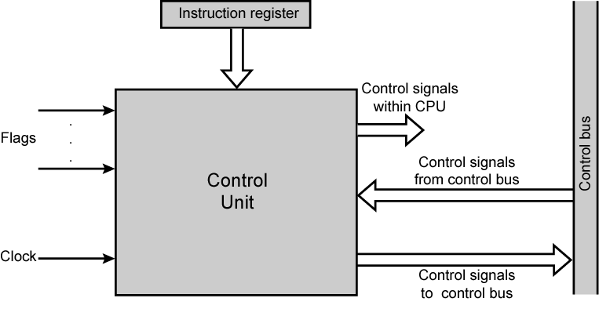
Block Schematic Diagram of Control Unit

Slide 19
Control Signals
Clock
One micro-instruction (or set of parallel micro-instructions) per clock cycle
Instruction register
Op-code for current instruction
Determines which micro-instructions are performed
Flags
State of CPU
Results of previous operations
From control bus
Interrupts
Acknowledgements

Slide 20
Control Signals - output
Within CPU
Cause data movement
Activate specific functions
Via control bus
To memory
To I/O modules

Slide 21
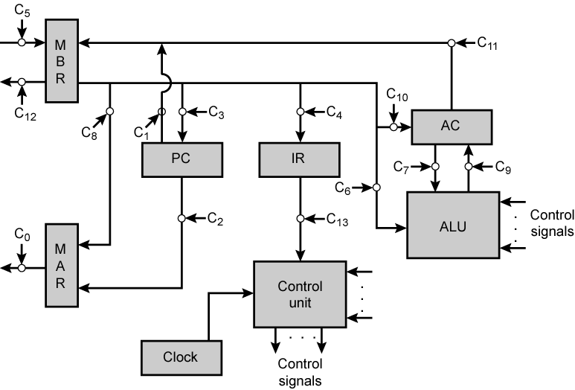
Data Paths and Control Signals

Slide 22
Example Control Signal Sequence - Fetch
MAR <- (PC)
Control unit activates signal to open gates between PC and MAR
MBR <- (memory)
Open gates between MAR and address bus
Memory read control signal
Open gates between data bus and MBR

Slide 23
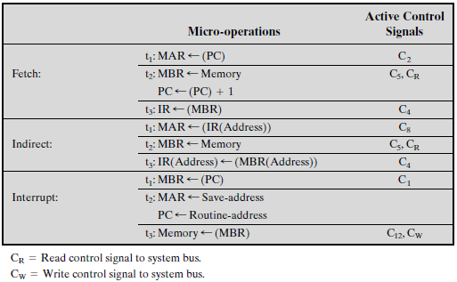
Micro-operations and Control Signals

Slide 24
Internal Organization
Usually a single internal bus
Gates control movement of data onto and off the bus
Control signals control data transfer to and from external systems bus
Temporary registers needed for proper operation of ALU

Slide 25
Fundamental Concepts
Processor (CPU): the active part of the computer, which does all the work (data manipulation and decision-making).
Datapath: portion of the processor which contains hardware necessary to perform all operations required by the computer (the brawn).
Control: portion of the processor (also in hardware) which tells the datapath what needs to be done (the brain).

Slide 26
Datapath
Datapath needs:
access to storage (general purpose registers and memory)
computational ability (ALU)
helper hardware (local registers and PC)
Five stages of datapath (executing an instruction):
Instruction Fetch (Increment PC)
Instruction Decode (Read Registers)
ALU (Computation)
Memory Access
Write to Registers
ALL instructions must go through ALL five stages.
Datapath is designed in hardware.

Slide 27
Single Bus Organization
Internal processor bus
Control signals
Address line
PC
. . .
Instruction decoder and control logic
Memory bus
MAR
Data line
MDR
Constant 4
IR
Y
Select
RO
MUX
:
:
ALU control lines
Add
Sub
A
B
R(n–1)
:
ALU
Carry-in
XOR
TEMP
Z

Slide 28
Single Bus Organization (cont..)
A single internal bus connects the ALU and all processor registers.
Gates and control movement of data onto and off the bus from each register.
Additional control signals control data transfer to and from the system (external) bus and the operation of the ALU.
Two temporary registers are needed for proper operation of ALU (Y: temporary input storage, Z: temporary output storage)

Slide 29
Single Bus Organization (cont..)
Advantages:
The use of common data paths simplifies the interconnection layout and the control of the processor.
It saves space.
Disadvantage:
Its control sequences are long as only one data item can be transferred over the bus in a clock cycle.

Slide 30
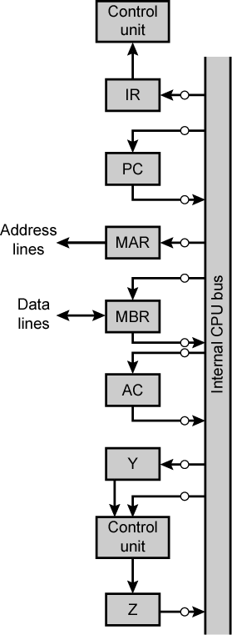
Single Bus Organization (cont..)
e.g. Usage of temporary registers
t1: MAR ← (IR(address))
t2: MBR ← Memory
t3: Y ← (MBR)
t4: Z ← (AC) + (Y)
t5: AC ← (Z)

Slide 31
Register Transfer
Register to register transfer:
For each register Ri, two control signals:
Ri_{in} used to load the data on the bus into the register.
Set Ri_{in} to 1 to load data from the processor bus into Ri.
Ri_{out} to place the register’s contents on the bus.
Set Ri_{out} to 1 to load contents of Ri on the bus.
Ri_{out}=0Bus can be used for transferring data from other registers
Example: To transfer contents of R1 to R4:
Set R1_{out} to 1. This places contents of R1 on the bus.
Set R4_{in} to 1. This loads data from the processor bus into R4.

Slide 32
Register Transfer (cont..)
Internal processor bus
Y_{in}
Ri_{in}
X
X
Constant 4
Ri
Y
X
Select
Ri_{out}
MUX
A
B
ALU
Z_{in}
X
Z
X
Z_{out}

Slide 33
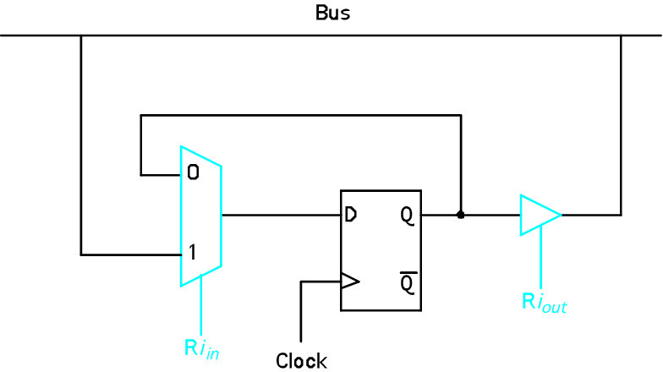
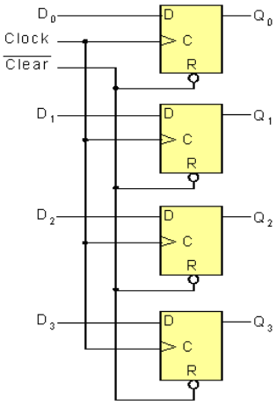
Register Transfer (cont..)
Input and output gating for one register bit
E.g. 4-bit register with D flip-flops:

Slide 34
Arithmetic/Logic Operation
Internal processor bus
ALU: Performs arithmetic and logic operations on its A and B inputs.
To perform
R3 ← [R1] + [R2]:
R1_{out}, Y_{in}
R2_{out}, SelectY, Add, Z_{in}
Z_{out}, R3_{in}
Y_{in}
Ri_{in}
X
X
Constant 4
Ri
Y
X
Select
Ri_{out}
MUX
A
B
ALU
Z_{in}
X
Z
X
Z_{out}

Slide 35
Arithmetic/Logic Operation (cont..)
If there are n operations, do we need n ALU control lines?
We could use encoding, which requires log₂ n control lines for n operations. However, this will increase complexity and hardware (additional decoder needed).
Add
ALU control lines
Sub
A
B
:
ALU
Carry-in
XOR

Slide 36
Reading a Word from Memory
E.g. Move (R1), R2 /* R2 ← [[R1]]
(opcode source destination)
MAR ← [R1]
Start a Read operation on the memory bus
Wait for the MFC response from the memory
Load MDR from the memory bus
R2 ← [MDR]
MDR has four
control signals:
MDR_{in},
MDR_{out},
MDR_{inE}
MDR_{outE}.
Memory-bus data lines
Internal processor bus
MDR_{inE}
MDR_{in}
X
X
MDR
X
X
MDR_{outE}
MDR_{out}

Slide 37
Reading a Word from Memory (cont..)
E.g. Move (R1), R2 /* R2 ← [[R1]]
Sequence of control steps:
R1_{out}, MAR_{in}, Read
MDR_{inE}, WMFC
MDR_{out}, R2_{in}
WMFC: Wait for arrival of MFC (Memory-Function-Completed) signal.
MFC: To accommodate variability in response time, the processor waits until it receives an indication that the Read/Write operation has been completed. The addressed device sets MFC to 1 to indicate this.

Slide 38
Storing a Word in Memory
Move R2, (R1) /* [R1] ← [R2]
Sequence of control steps:
R1_{out}, MAR_{in}
R2_{out}, MDR_{in}, Write
MDR_{outE}, WMFC

Slide 39
Executing a Complete Instruction
E.g. Add (R3), R1 /* R1 ← [R1] + [[R3]]
Adds the contents of a memory location pointed
to by R3 to register R1.
Sequence of control steps:
PC_{out}, MAR_{in}, Read, Select4, Add, Z_{in}
Z_{out}, PC_{in}, Y_{in}, WMFC
MDR_{out}, IR_{in}
R3_{out}, MAR_{in}, Read
R1_{out}, Y_{in}, WMFC
MDR_{out}, SelectY, Add, Z_{in}
Z_{out}, R1_{in}, End
Steps 1 – 3: Instruction fetch
Steps 4 – 7: Execution fetch

Slide 40
Branch Instruction
A branch instruction replaces the contents of PC with the branch target address.
It is usually obtained by adding an offset X, which is given in the branch instruction, to the updated value of PC.
E.g. Unconditional branch
Sequence of control steps:
PC_{out}, MAR_{in}, Read, Select4, Add, Z_{in}
Z_{out}, PC_{in}, Y_{in}, WMFC
MDR_{out}, IR_{in}
Offset-field-of- IR_{out} , SelectY, Add, Z_{in}
Z_{out}, PC_{in}, End

Slide 41
Branch Instruction (cont..)
For conditional branch we need to check the status of the condition codes before loading a new value into the PC.
E.g. Branch-on-negative(Branch<0)
Sequence of control steps:
PC_{out}, MAR_{in}, Read, Select4, Add, Z_{in}
Z_{out}, PC_{in}, Y_{in}, WMFC
MDR_{out}, IR_{in}
Offset-field-of- IR_{out} , SelectY, Add, Z_{in} , If N=0 then End
Z_{out}, PC_{in}, End
Here, if N=0 the processor returns to step 1 immediately after step 4.
If N=1. step 5 is performed to load a new value into the PC, thus performing the branch condition.

Slide 42
Multiple-Bus Organization
Need:
In Single-bus structure control sequences are long as only one data item can be transferred over the bus in a clock cycle.
To reduce the number of steps needed, most commercial processors provide multiple internal paths that enable several transfers to take place in parallel.
Buses A and B are used to transfer source operands to the A and B inputs of ALU, and result transferred to destination over bus C.
The three-bus arrangement obviates the need for registers Y and Z.

Slide 43
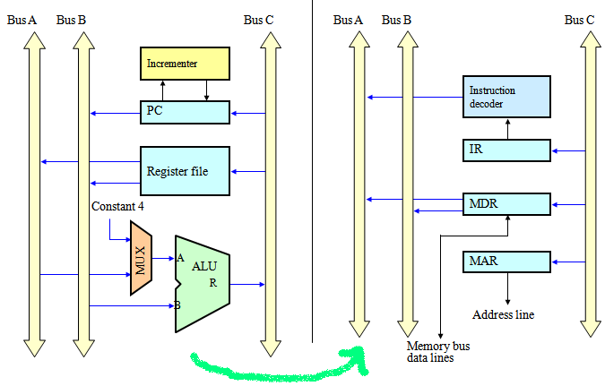
Multiple-Bus Organization (cont..) Three-Bus Structure

Slide 44
Multiple-Bus Organization (cont..)
All general purpose registers are combined into a single block called register file with three ports:
2 outputs allowing 2 registers to be accessed simultaneously and have their contents put on buses A and B, and
1 input allowing data on bus C to be loaded into a third register.
Use of incrementer unit(for incrementing PC by 4)eliminates need to add 4 to PC using main ALU.
Constant 4 at ALU i/p multiplexer is still useful for incrementing other addresses such as memory addresses in LoadMultiple/ StoreMultiple instructions.

Slide 45
Multiple-Bus Organization (cont..)
For the ALU, R=A (or R=B) means that its A (or B) input is passed unmodified to bus C.
E.g. Add R4, R5, R6 /* R6 ← [R4] + [R5]
Adds the contents of R4 and R5 to R6.
Sequence of control steps:
PC_{out}, R=B, MAR_{in}, Read, IncPC
WMFC
MDR_{outB}, R=B, IR_{in}
R4_{outA}, R5_{outB}, SelectA, Add, R6_{in}, End

Slide 46
Control Systems
Two categories:
Hardwired control
Control unit is implemented using hardware.
It physically connects all of the control lines to actual machine instructions.
The control unit is essentially a state machine circuit.
Its input logic signals are transformed into a set of output logic signals, which are the control signals.
Micro programmed control
Control unit is implemented using software.
The logic of the control unit is specified by a microprogram.
A microprogram consists of a sequence of instructions in a microprogramming language.
These are very simple instructions that specify micro-operations.

Slide 47
Hardwired Control (cont..)
A special digital circuit that uses:
The bits from the opcode field in our instructions(IR)
Bits from the Condition code flags
Signals from the bus such as MFC, interrupt signals
Signals from the Control step counter
CLK
Control step counter
Clock
. . .
IR
Decoder/ encoder
External inputs
:
:
:
Condition codes
:
. . .
Control signals

Slide 48
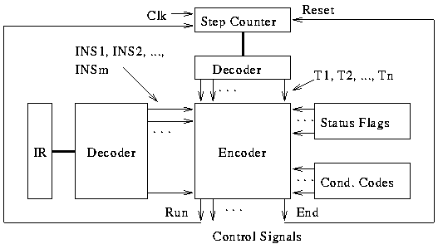
Hardwired Control (cont..) Detailed Block Description

Slide 49
Hardwired Implementation
Instruction register
Op-code causes different control signals for each different instruction(INST₁, INST₂, ....)
Unique logic for each op-code
Decoder takes encoded input and produces single output
n binary inputs and 2^{n} outputs
Flags and control bus
Each bit means something

Slide 50
Hardwired Implementation (cont..)
Control unit inputs
Clock
Repetitive sequence of pulses
Useful for measuring duration of micro-ops
Must be long enough to allow signal propagation
Different control signals at different times within instruction cycle
Need a counter with different control signals for T₁, T₂ etc.

Slide 51
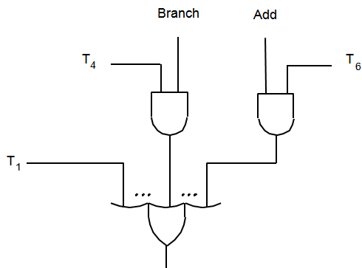
Hardwired Control (cont..) Generating Z_{in}
Z_{in} = T₁ + T₆ • ADD + T₄ • BR + …
Generation of the Z_{in} control signal for the processor

Slide 52
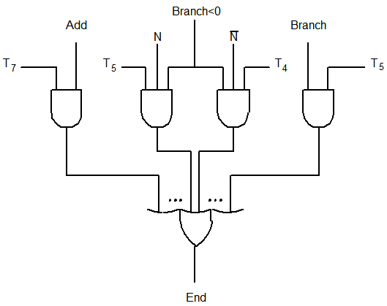
Hardwired Control (cont..) Generating End
Generation of the END control signal for the processor

Slide 53
Hardwired Control (cont..)
For memory operations, need a circuit which:
Holds read/write until MFC received.
Disables RUN until MFC received.
Advantage:
Faster Speed
Disadvantages:
Instruction set and Control logic are directly tied together using complicated circuits that are difficult to design and test.
Inflexible to modify
Expensive
Complex sequencing & micro-operation logic

Slide 54
Design Methods for Hardwired Control
Sequence Counter Method:
The most popular method conveniently employed for design of controllers with moderate complexity
Delay Element Method
It depends on the use of clocked delay elements for generating the control signals
State Table Method
It employs the traditional algorithmic approach to sequential circuit design using classical state table method.

Slide 55
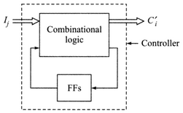
State Table Method
The states S_{i} (i=1,2…) of the controller generate the control signals to control the micro operations in the data path.
A controller in state ,say S_{i}, on receiving the primary input signals I_{j} switches over to the state S_{i’} while generating the output signals {C’_{i}}.
This set of output signals {C’_{i}} execute the micro operations.

Slide 56
State Table Method (cont..)
It includes following steps:
State assignment: It specifies the particular state of the controller at the specific time stamp.
State Minimization: A set of states (S_{a}, S_{b}, …S_{c} ) can be merged into a single state S’ if S_{i} and S_{j} (i≠j, i,j=a,b,c..) is pairwise compatible i.e. the output sequence {O_{i}} and {O_{j}} (that result from any input sequence I to the control unit in state S_{i} and S_{j} as initial states) are identical whenever they are specified.
State Encoding: State variables are defined and states are encoded in terms of state variables.

Slide 57
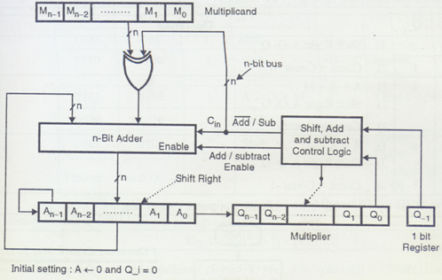
Multiplier Unit (Hardware Implementation of Booth’s Algorithm)

Slide 58
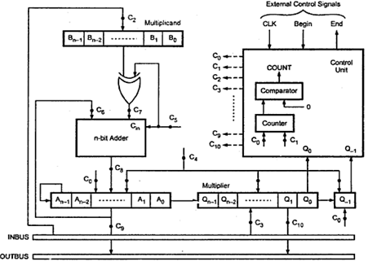
Multiplier Control Unit with Control Signals

Slide 59
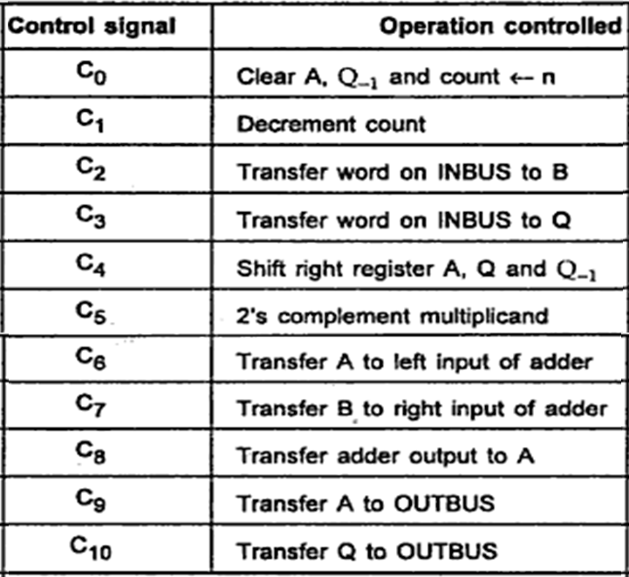
Control Signals for the 2’s Complement Multiplier

Slide 60





Slide 61

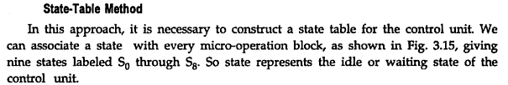



Slide 62
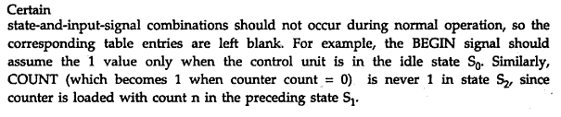

Slide 63
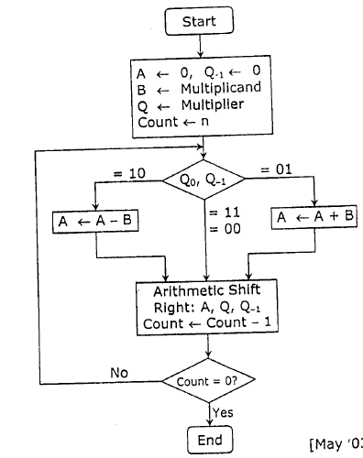
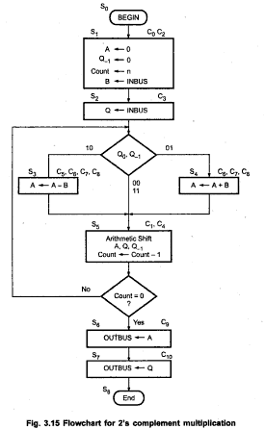

Slide 64
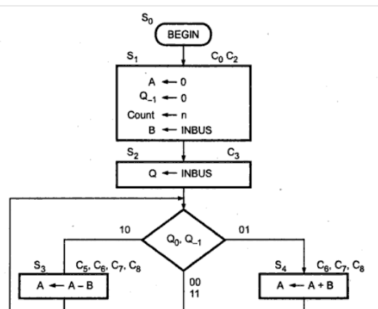

Slide 65
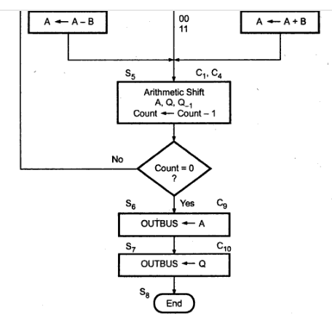

Slide 66
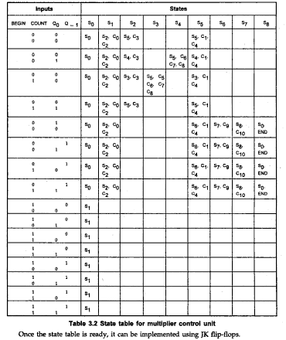

Slide 67
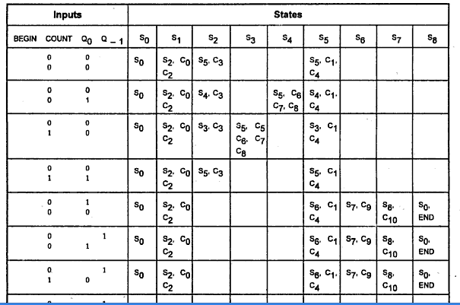

Slide 68
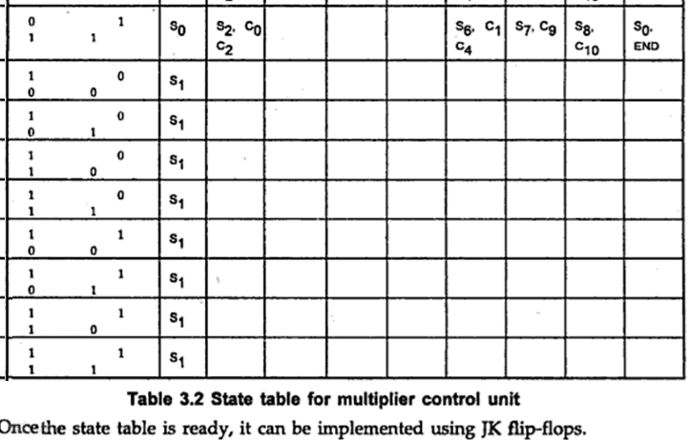

Slide 69
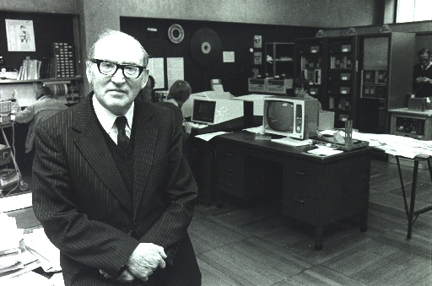
Microprogrammed Control
Developed by M.V. Wilkes in the early 1950’s
Proposed an idea that was organized & systematic and avoided the complications of hardwired implementation.
It is called micro-programming or firmware.
Control signals are generated by a program similar to machine language programs.

Slide 70
Microprogrammed Control (cont..)
A microprogrammed control unit is a relatively simple logic circuit that is capable of :
sequencing through microinstructions and
Generating control signals to execute each microinstruction.
A sequence of microinstructions constitutes a microprogram.
Microprogram is an interpreter written in microcode that is stored in firmware(ROM, PROM, EEPROM) which is often called the control store.
The program converts zero’s and one’s into control signals.

Slide 71
Microprogrammed Control (cont..)
Control word (CW) is a word whose individual bits represent the various control signals.
Each of the control steps in the control sequence of an instruction defines a unique combination of 1s and 0s in the CW.
A sequence of CWs corresponding to the control sequence of machine instruction constitutes the microroutine for that instruction.
The individual control words in a microroutine are referred to as microinstructions.
Each microinstruction specifies one or more microoperations that is performed.

Slide 72
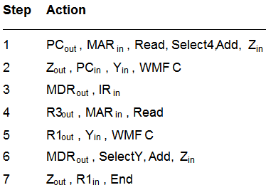
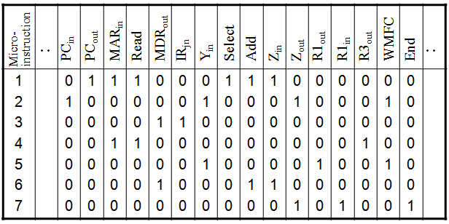

Example of Micro-instruction
E.g. ADD (R3), R1

Slide 73
Basic organization of a microprogrammed control unit
To read CWs sequentially from the control store a microprogram counter(μPC) is used.
Every time the new instruction is loaded into IR.
The output of “starting address generator” is loaded into μPC.
μPC is then automatically incremented by the clock, causing successive microinstructions to be read from control store.
Hence the control signals are delivered to various parts of the processor in the correct sequence.

Slide 74
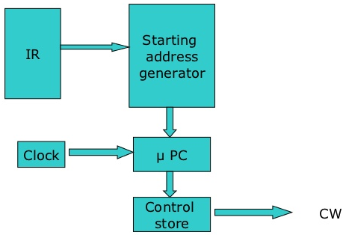
Basic organization of a microprogrammed control unit
Micoprogrammed control is popular in Complex Instruction Set Architectures (CISC) because complex instruction sets require complex controllers that can more easily be implemented as microprograms.

Slide 75
Conditional branch
The previous organization cannot handle the situation when the control unit is required to check the status of the condition codes or external inputs to choose between alternative courses of action.
Address
Microinstruction
0
PC
out
,
MAR
in
,
Read,
Select4,
Add,
Z
in
1
Z
out
,
PC
in
,
Y
in
,
WMF
C
2
MDR
out
,
IR
in
3
Branch
to
starting
address
of
appropriate
microroutine
.
.
.
.
.
.
.
.
.
.
.
.
.
.
.
.
.
.
.
.
.
.
.
.
.
.
.
.
.
.
.
.
.
.
.
.
.
.
.
.
.
.
.
.
.
.
.
.
.
.
.
.
.
.
.
.
.
.
.
.
.
.
.
.
.
.
25
If
N=0,
then
branch
to
microinstruction
0
26
Offset-field-of-IR
out
,
SelectY,
Add,
Z
in
27
Z
out
,
PC
in
,
End
Figure 7.17. Microroutine for the instruction Branch<0.

Slide 76
Conditional branch(cont..)
External
inputs
Starting and
Condition
IR
branch address
codes
generator
Clock
μ
P
C
Control
CW
store
Organization of the control unit to allow conditional branching in the microprogram.

Slide 77
Microinstructions
A straightforward way to structure microinstructions is to assign one bit position to each control signal (total 42 control signals).
However, this is very inefficient:
It results in long microinstructions(42-bit long).
Only a few bits are set to 1(to be used for active gating) in any given microinstruction which means the available bit space is poorly used.
Most signals are not needed simultaneously, and many signals are mutually exclusive.

Slide 78
Microinstructions (cont..)
The length of the microinstruction can be reduced:
All mutually exclusive signals are placed in the same group in binary coding.
Thus at most one microoperation per group is specified at a time in any microinstruction.
Binary encoding scheme is used to represent the signals within a group.
Require a little more hardware-Decoding circuit
Smaller control word(20 bits instead of 42 bits)

Slide 79
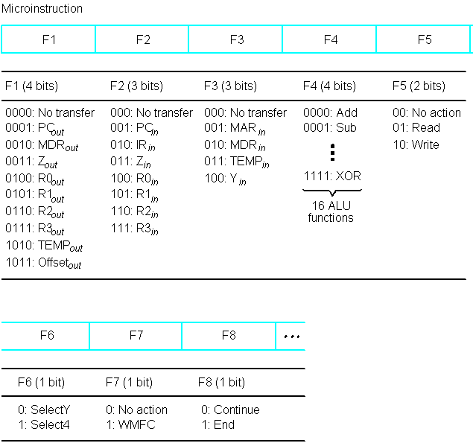
Partial Format for field-encoded Micro-instruct-ions

Slide 80
Microinstructions (cont..)
Enumerate the patterns of required signals in all possible microinstructions.
Each meaningful combination of active control signals can then be assigned a distinct code.
Such full encoding is likely to further reduce the length of microwords but also to increase the complexity of the required decoder circuits.

Slide 81
Microinstructions (cont..)
Vertical organization:
Highly encoded schemes that use compact codes to specify only a small number of control functions in each microinstruction.
Slower operating speeds.
Less hardware needed to handle the execution of microinstructions
Horizontal organization:
Minimally encoded scheme in which many resources can be controlled with a single microinstruction.
Useful when higher operating speed is required and machine structure allows parallel use of resources.

Slide 82
Microinstructions (cont..)
Example of a horizontal organization scheme:
PC_{out}, MAR_{in}, Read, Select4, Add, Z_{in}
Z_{out}, PC_{in}, Y_{in}, WMFC
MDR_{out}, IR_{in}
R3_{out}, MAR_{in}, Read
R1_{out}, Y_{in}, WMFC
MDR_{out}, SelectY, Add, Z_{in}
Z_{out}, R1_{in}, End
Micro-instruction
1 2 3 4 5 6 7 |  | 0 1 0 0 0 0 0 | 1 0 0 0 0 0 0 | 1 0 0 1 0 0 0 | 1 0 0 1 0 0 0 | 0 0 1 0 0 1 0 | 0 0 1 0 0 0 0 | 0 1 0 0 1 0 0 | 1 0 0 0 0 0 0 | 1 0 0 0 0 1 0 | 1 0 0 0 0 1 0 | 0 1 0 0 0 0 1 | 0 0 0 0 1 0 0 | 0 0 0 0 0 0 1 | 0 0 0 1 0 0 0 | 0 1 0 0 1 0 0 | 0 0 0 0 0 0 1
PC_{in}
PC_{out}
MAR_{in}
Read
MDR_{out}
IR_{jn}
Y_{in}
Select
Add
Z_{in}
Z_{out}
R1_{out}
R1_{in}
R3_{out}
WMFC
End
..
..
Select=0: SelectY
Select=1: Select4

Slide 83
Microprogram Sequencing
If all microprograms require only straightforward sequential execution of microinstructions except for branches, letting a μPC governs the sequencing would be efficient.
However, two disadvantages:
Having a separate microroutine for each machine instruction results in a large total number of microinstructions and a large control store.
Longer execution time because it takes more time to carry out the required branches.
Example: Add src, Rdst
Four addressing modes: register, autoincrement, autodecrement, and indexed (with indirect forms).
Combining simple microroutines by sharing common parts
The microinstruction is located at the address indicated by the octal number above the upper right-hand corner of the box in the flowchart.

Slide 84
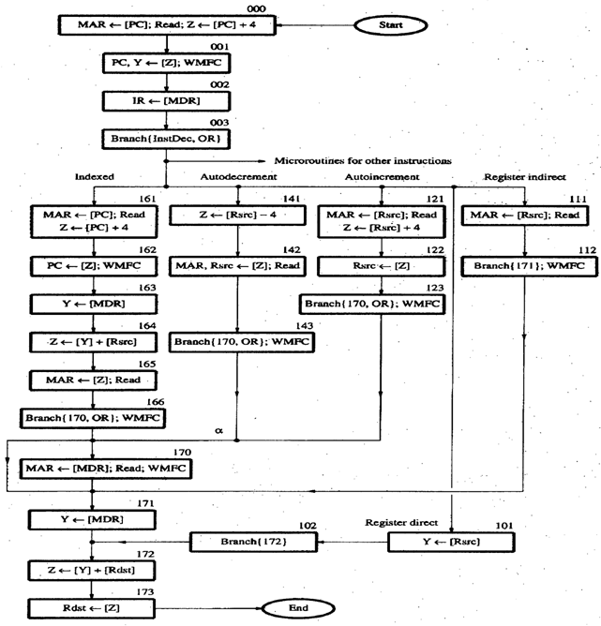
Flowchart of a micro-program
e.g.
Add src, Rdst

Slide 85
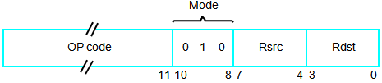
Microprogram Sequencing (cont..)
Branch-address Modification :
Using Bit-ORing (e.g. By ORing LSB we get addr 170 for Indirect, 171 for direct)
Conditional Branch
Use of two next address fields(indirect & direct)
Use of WMFC
Contents of IR:
Assume 3 bits(no.10,9,8) for addressing mode:
Bit 8: 0=Direct mode, 1= Indirect mode
Bits 10,9: 00= Register
01= Autoincrement
10= Autodecrement
11= Indexed

Slide 86
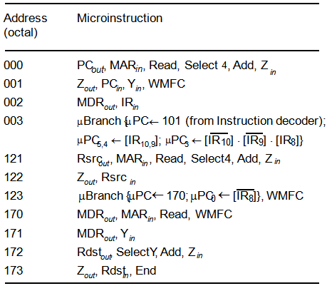
Microprogram Sequencing (cont..)
Microinstruction for Add (Rsrc)+,Rdst.
autoincrement mode; microinstruction at location 170 is not executed for this addressing mode

Slide 87
Microinstructions with Next-Address Field
The microprogram we discussed requires several branch microinstructions, which perform no useful operation in the datapath.
A powerful alternative approach is to include an address field as a part of every microinstruction to indicate the location of the next microinstruction to be fetched.
Every microinstruction becomes a branch microinstruction , in addition to its other function.

Slide 88
Microinstructions with Next-Address Field
Advantages:
Separate branch microinstructions are virtually eliminated;
Few limitations in assigning addresses to microinstructions.
No need to keep track of sequential addresses. So µPC is replaced by Microinstruction Address Register (µAR).
Drawbacks:
Additional bits for the address field (around 1/6th of control store capacity)

Slide 89
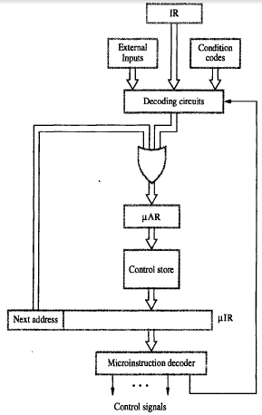
Microinstructions with Next-Address Field
Microinstruction sequencing organization

Slide 90
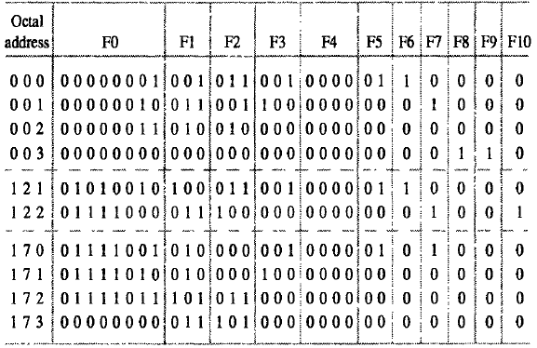
Implementation of the Microroutine
Micro routine using next-address field
e.g. Add (Rsrc)+,Rdst

Slide 91
Tasks Done By Microprogrammed Control Unit
Microinstruction sequencing:
Get the next microinstruction from the control memory.
Microinstruction execution:
Generate the control signals needed to execute the microinstruction.
Must consider both together
Design Considerations:
Size of microinstructions
Address generation time
Determined by instruction register
Once per cycle, after instruction is fetched
Next sequential address
Common in most designed
Branches
Both conditional and unconditional

Slide 92
Sequencing Techniques
Based on current microinstruction, condition flags, contents of IR, control memory address must be generated
Based on format of address information
Two address fields
Single address field
Variable format

Slide 93
Address Generation
Explicit | Implicit
Two-field | Mapping
Unconditional Branch | Addition
Conditional branch | Residual control

Slide 94
Microinstruction Execution
The microinstruction cycle is the basic event on a microprogrammed processor.
Each cycle is made up of two events
Fetch
Determined by generation of microinstruction address
Execute
Effect of the execution of a microinstruction:
to generate control signals
Some control points internal to processor
Rest go to external control bus or other interface

Slide 95
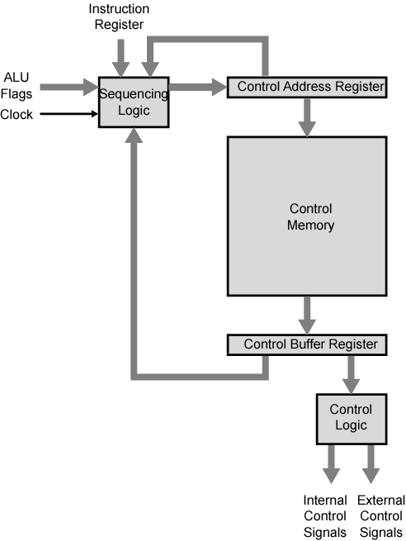
Control Unit Organization

Slide 96
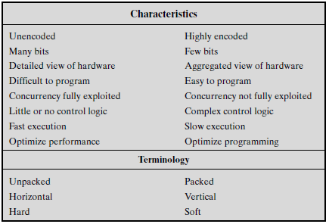
The Microinstruction Spectrum

Slide 97
A Taxonomy of Microinstructions
Microinstructions can be classified in a variety of ways:-
Vertical/horizontal
Packed/unpacked
Hard/soft microprogramming
Direct/indirect encoding
Vertical/horizontal:
relate to the relative width of microinstructions.
a rule of thumb: vertical microinstructions have lengths in the range of 16 to 40 bits and horizontal microinstructions have lengths in the range of 40 to 100 bits.

Slide 98
A Taxonomy of Microinstructions (cont..)
Packed/unpacked:
The degree of packing relates to the degree of identification between a given control task and specific microinstruction bits.
As the bits become more packed, a given number of bits contains more information. Thus, packing connotes encoding.
Hard/soft microprogramming
Suggest the degree of closeness to the underlying control signals and hardware layout.
Hard microprograms are generally fixed and committed to read-only memory.
Soft microprograms are more changeable and are suggestive of user microprogramming.

Slide 99
A Taxonomy of Microinstructions (cont..)
Direct/indirect encoding:
Two approaches can be taken to organizing the encoded microinstruction into fields: functional and resource.
Organize the format into independent fields. That is, each field depicts a set of actions (pattern of control signals) such that actions from different fields can occur simultaneously.
Define each field such that the alternative actions that can be specified by the field are mutually exclusive. That is, only one of the actions specified for a given field could occur at a time.
Direct encoding generally implies one level of decoding.
Indirect encoding generally implies two levels of decoding.

Slide 100
Encoding: Improvements over Wilkes
Wilkes had each bit directly produced a control signal or directly produced one bit of next address
More complex address sequencing schemes,
using fewer microinstruction bits, are possible
Require more complex sequencing logic module
Control word bits can be saved by encoding and subsequently decoding control information

Slide 101
How to Encode
K different internal and external control signals
Wilkes’s:
K bits dedicated
2^{K} control signals during any instruction cycle
Not all of these are used:
Two sources cannot be gated to same destination
Register cannot be source and destination
Only one pattern presented to ALU at a time
Only one pattern presented to external control bus at a time
Require Q < 2^{K} which can be encoded with (log₂Q )< K bits
Practically it is not done:
As difficult to program as pure decoded (Wilkes) scheme
Requires complex slow control logic module
Compromises
More bits than necessary used
Some combinations that are physically allowable are not possible to encode

Slide 102
Specific Encoding Techniques
Microinstruction organized as set of fields
Each field contains code
Activates one or more control signals
Organize format into independent fields
Field depicts set of actions (pattern of control signals)
Actions from different fields can occur simultaneously
Alternative actions that can be specified by a field are mutually exclusive
Only one action specified for field could occur at a time

Slide 103
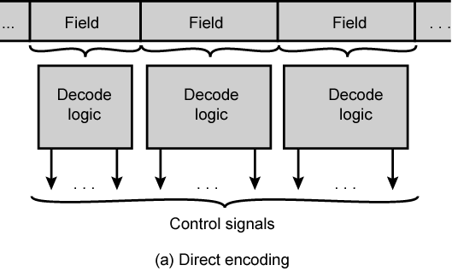
Microinstruction Encoding: Direct Encoding
The microinstruction is organized as a set of fields.
Each field contains a code, which, upon decoding, activates one or more control signals.
Thus, with N fields, N simultaneous actions are specified. Each action results in the activation of one or more control signals.

Slide 104
Microinstruction Encoding: Indirect Encoding
One field is used to determine the interpretation of another field.
e.g. Consider an ALU that is capable of performing eight different arithmetic operations and eight different shift operations. A 1-bit field could be used to indicate whether a shift or arithmetic operation is to be used; a 3-bit field would indicate the operation.
This technique generally implies two levels of decoding, increasing propagation delays.

Slide 105
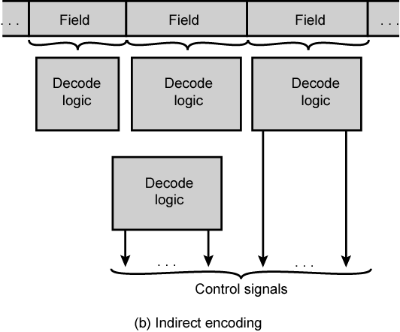
Microinstruction Encoding: Indirect Encoding (cont..)

